Slide 1

Introduction to xarray
Managing and analyzing multidimensional datasets

Slide 2

Programme: four blocks
Introduction to DataArrays and Datasets, reading/writing
Plotting capacities
First analyses
Scaling analysis
with dask
!

Slide 3
Part I: xarray objects
DataArrays and Datasets

Slide 4
Comparison with pandas
Multivariable objects, aligned on similar axes/indices
pd.DataFrame
xr.Dataset
Single variable object:
pd.Series
xr.DataArray
Single variable object :
pd.Series
xr.DataArray
Single variable object :
pd.Series
xr.DataArray

Slide 5

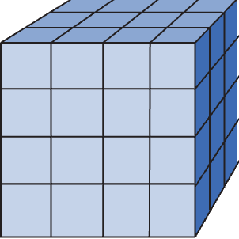



xr.DataArray: presentation
Array of values representing a unique variable:
  « Wrapping » around a numpy array
Coordinate 1
Attributes: additional metadata
Data: numpy array
Coordinate 2
Dimension 3
Dimension 2
Coordinate 3
Dimension 1

Slide 6
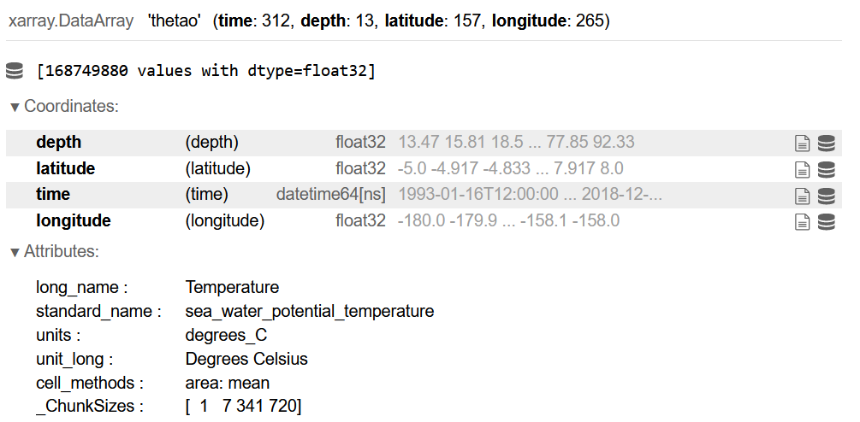
xr.DataArray: presentation
Exemple of a DataArray

Slide 7
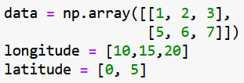
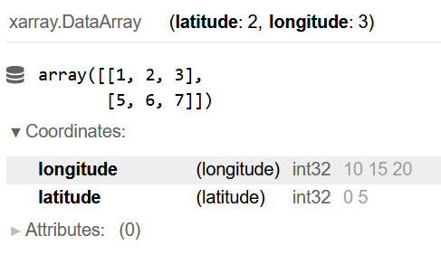
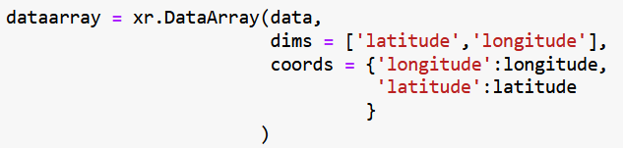
xr.DataArray: creating an object
Source: an n-dimensional numpy array + n lists of coordinates
Use xr.DataArray()

Slide 8

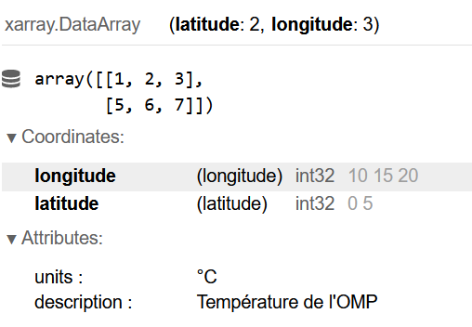
xr.DataArray: adding attributes
DataArray.attrs is a dictionnary that can be modified

Slide 9
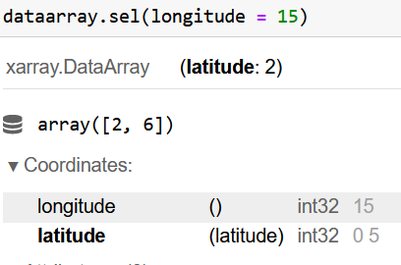
xr.DataArray: accessing the data
Xarray basics !
  Access data using coordinates

Slide 10
xr.DataArray: accessing the data
Also works for a list of multiple coordinates
Select using position (like in numpy)
Access the numpy array

Slide 11
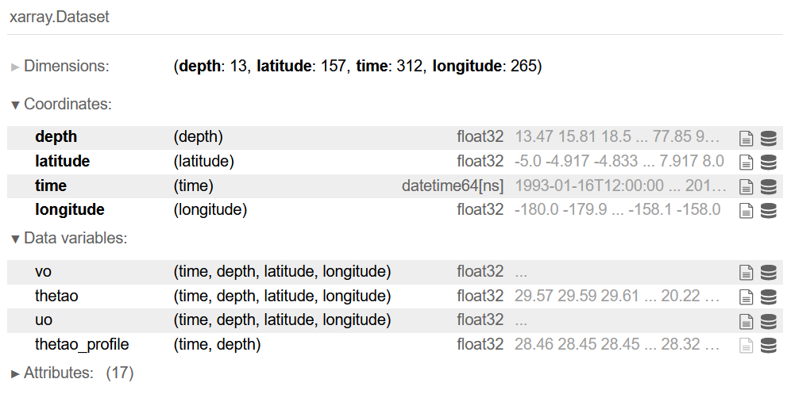
xr.Dataset: presentation
Multiple DataArrays with shared dimensions
xr.DataArray
Global attributes
Dimensions of each DataArray

Slide 12

xr.Dataset: creating an object
Sources:
  An ensemble of DataArrays
xr.Dataset()

Slide 13

xr.Dataset: access the data
Access one DataArray
Other access are similar to a DataArray:
  dataset.sel(latitude=…)
  dataset.isel(longitude=[..])

Slide 14
xr.Dataset: append data
Add a DataArray as a new variable
  Add a variable as if you wanted to access it:
This can also be used to replace the values of a given DataArray

Slide 15
Operations on coordinates
Simple operations between DataArrays based on coordinates:
DataArray1**2 + DataArray2/12
Create new variables in a dataset from existing variables:
ds[‘new_variable’] = ds[‘old_v1’]**2 + ds[‘old_v2’]/12

Slide 16
Combine dataarrays or datasets
Concatenate along existing dimensions
  Example: different times but similar geographical grids
Concatenate along new dimensions

Slide 17
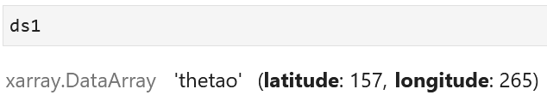
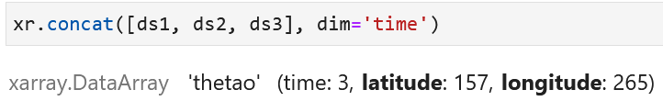
Combine dataarrays or datasets
latitude
ds1
ds2
ds3
ds
latitude
longitude
xr.concat([ds1,ds2,ds3],
dim=‘time’)
time
longitude

Slide 18
Reading/writing files: supported formats
Xarray supports many different format for reading and writing
  netCDF
  Other examples
    GRIB
    geoTIFF
    zarr
    …
Optimized for gridded data
Can open directly online (OpenDAP, cloud buckets, …)

Slide 19
Reading/writing files: reading a file
To open a netcdf file, use xr.open_dataset()
There is also open_dataarray if there is only one variable
Reading multiple files with xr.open_mfdataset:
  With a pattern
  With a list of paths

Slide 20

Reading/writing files: writing a file
To save a file, use Dataset.to_format()

Slide 21
Part I: Summary of xarray objects
Wrap numpy arrays with:
Dimensions that have names (lon, lat, time, depth, altitude, …)
Coordinates that have values
Attributes
DataArray: for a unique variable (equivalent to pd.Series)
Dataset: for multiple variables on the same « grid » (equivalent to pd.DataFrame)
Access data using variable names and coordinates
ds.temperature.sel(lon=54, lat=[12,13,14])

Slide 22

Part I: Practicals
Go to the jupyter notebook

Slide 23
Part II: plotting capacities

Slide 24
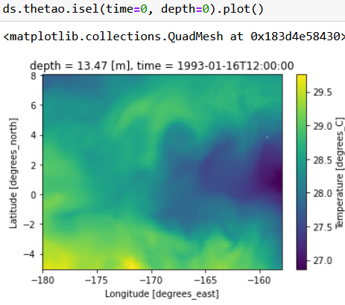
Plotting DataArrays
As pandas, xarray integrates matplotlib (+ other backends)
Plot shows coordinates, dimensions and attributes

Slide 25
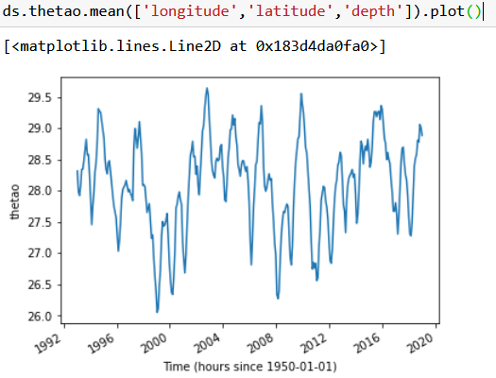
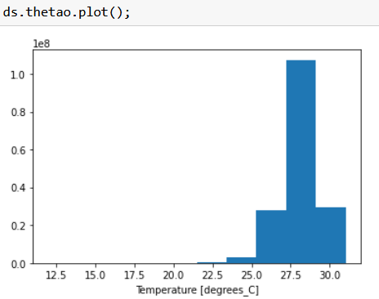
Plotting DataArrays: default behaviour
Line plot for 1d data
Quadmesh for 2D data
Histogram if more than 2D

Slide 26
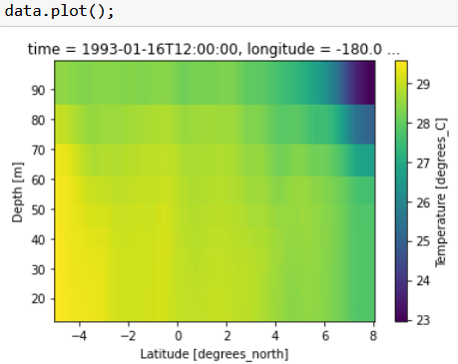
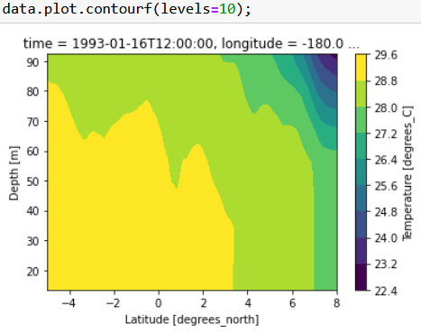
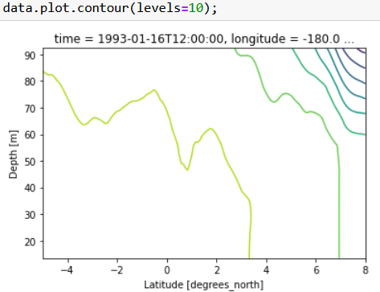
Plotting DataArrays: possible 2D plots
Important keywords:
x, y
levels: number of levels or list, cmap
add_colorbar=True/False
DataArray.plot.quadmesh()
DataArray.plot.contourf()
DataArray.plot.contour()
Important key words:
x=‘longitude’ | Variable in x | levels=10 | Number of levels or list
y=‘depth’ | Variable in y | cmap=‘magma’ | Changes colormap
yincrease=True | Reverses y values | robust=True | Truncates extreme values

Slide 27
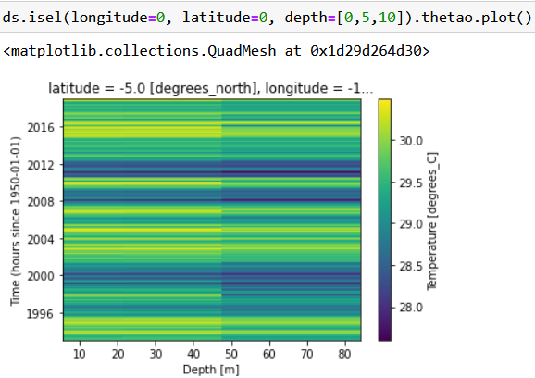
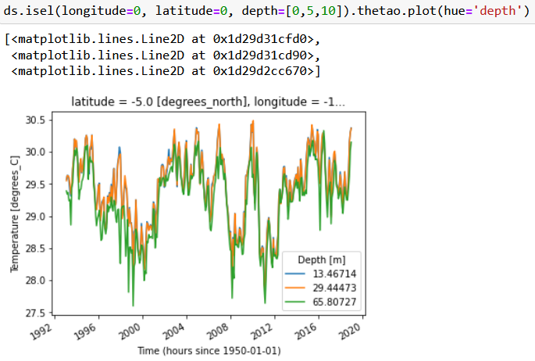
Plotting DataArrays: reduce plot dimension
Plot 2D data as multiple line plots with the keword hue

Slide 28
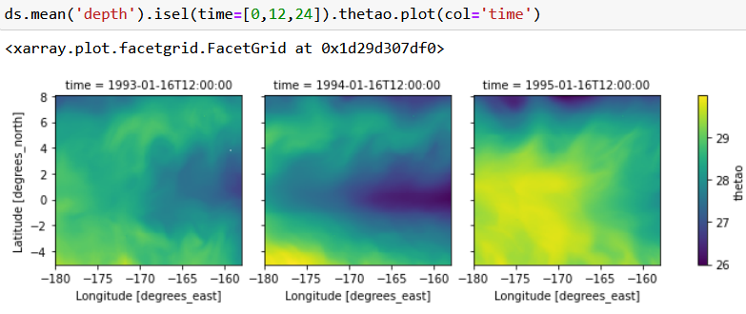
Plotting DataArrays: reduce plot dimension
Plot 3D data as multiple 2D plots with the kewords col/row
Use col_wrap=5 if there are two many columns

Slide 29
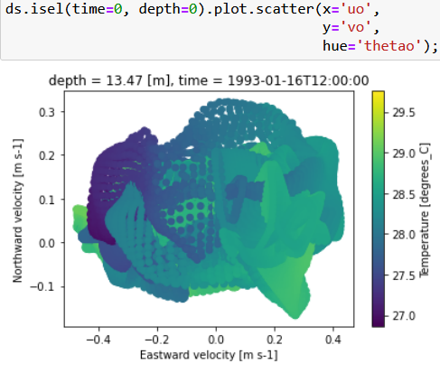
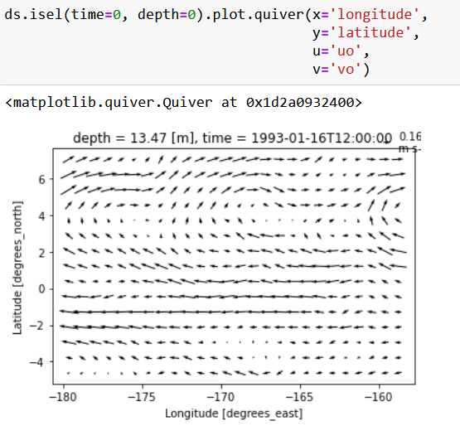
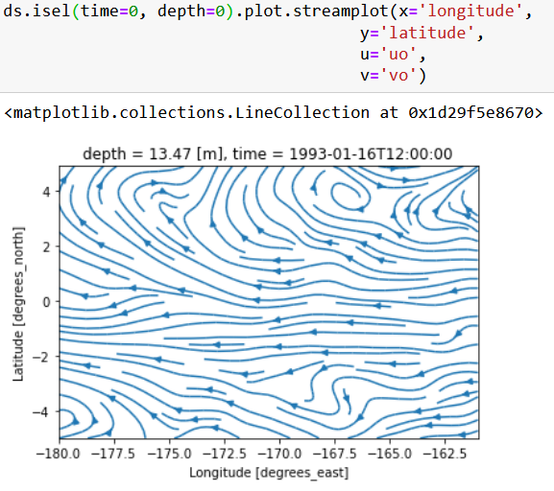
Plotting datasets
You can plot relationship between different variables of the same dataset
Dataset.plot.scatter(x,y)
Dataset.plot.quiver(x,y,u,v)
Dataset.plot.streamplot(x,y,u,v)

Slide 30
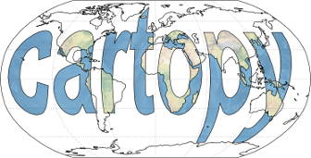
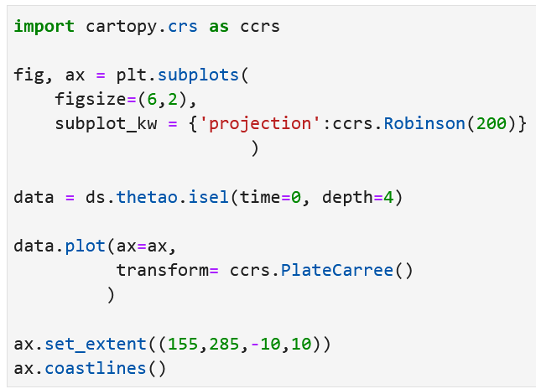
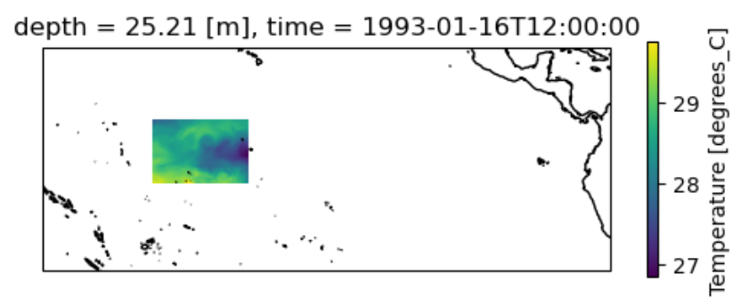
Bonus: integration with cartopy
Import cartopy
Prepare figure
Declare projection
Plot data
Declare coordinate system
Change limits/add coastline

Slide 31
Part II: Practicals
Go to the jupyter notebook

Slide 32
Part III: First analyses
Data selection
Statistical operations
Aggregations, …

Slide 33
Part III: First analyses
Data selection
Statistical operations
Aggregations, …

Slide 34
Selecting data
Select by coordinates
Select by position
Unique selection
Selection from list
Multicriteria
Nearest neighbour

Slide 35
Selecting data
Range of coordinates: slice(beginning, end)
  Select all values between beginning and end
Temporal selection (similar to pandas):
  Exact selection
  Selection of a period
  Selection of a time span

Slide 36
Selecting data
Masking data with Dataset.where
  Selects the data that fulfill a certain condition, the rest will be NaN.
  The condition is a boolean dataarray (True/False) on the same coordinates
  When the condition is on the coordinates, extract the data with drop=True

Slide 37
Part III: First analyses
Data selection
Statistical operations
Aggregations, …

Slide 38
Numpy-like operations
Use DataArray.operation(‘dimension’) for one object
Same for Datasets
Generally the same operations as in pandas
  mean(),sum(), min(), max(), median()
  idxmax(), idxmin(), argmin(), argmax()
  quantile([q1,q2, … ])
  count()

Slide 39

Some advanced methods
Difference from one step to another
Cumulative sum
Gradient, integral

Slide 40
Weighted operations
Weighted operations are possible !
The weights are a DataArray with similar dimensions/coordinates
  Example: Global average weighted by cell area of a climate model

Slide 41
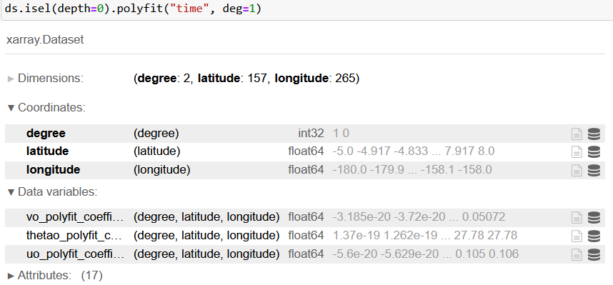
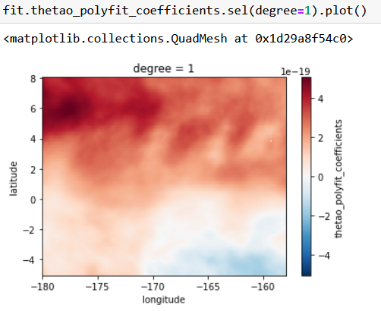

Fitting a DataArray or a dataset
Polynomial fits or general curve fits as with scipy/numpy

Slide 42
Big warning: no loops !
There is (almost) always a way to replace a
slow loop by a fast xarray function
Example : create new dimension instead of loop

Slide 43
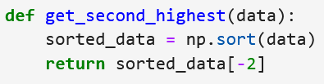
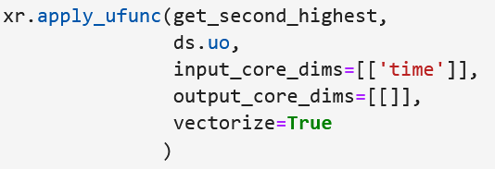
BONUS: Applying custom function to some dimension
Define custom function:
Apply it to certain dimensions with xr.apply_ufunc:

Slide 44
Part III: First analyses
Data selection
Statistical operations
Aggregations, …

Slide 45
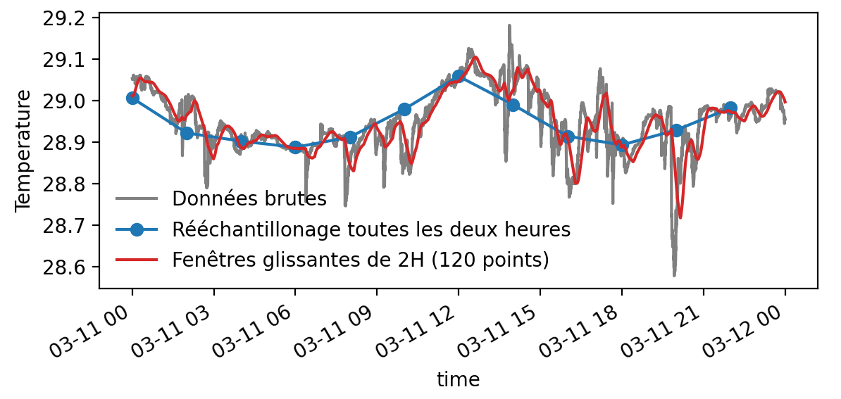
Resampling and rolling windows: in time
In time: similar to pandas
Resampling:
Rolling windows:
ds.resample(time="2H").mean()
ds.rolling(time=120).median()

Slide 46
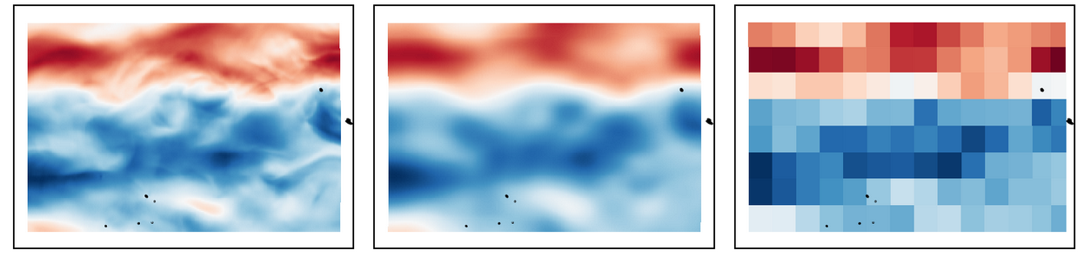
Resampling and rolling windows: in other dimensions
Resampling:
Rolling windows:
ds.coarsen(longitude=20, latitude=20, boundary='pad’).mean()
ds.rolling(longitude=20, latitude=20, center=True).max()
Raw DataArray
DataArray.rolling(lon=20, lat=20)
DataArray.coarsen(lon=20, lat=20)

Slide 47
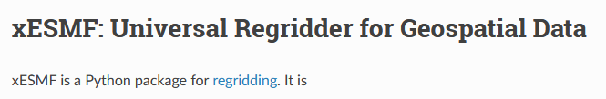
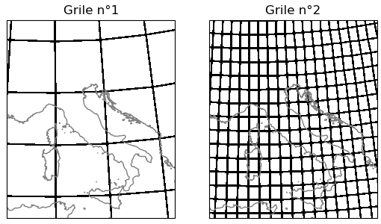
Bonus: regridding with xesmf
Grid 1
Grid 2
Curvilinear grid (e.g. NEMO, global ocean model)
Rectilinear grid (regular lon/lat grid)

Slide 48
Interpolation
Interpolate on new coordinate values
Fill missing values:

Slide 49
Operations on groups
Use Dataset.groupby() to compute on separate groups of data (as in pandas)
  Apply operation on each group
Temporal groupby using Dataset.groupby(‘time.XXX’):

Slide 50
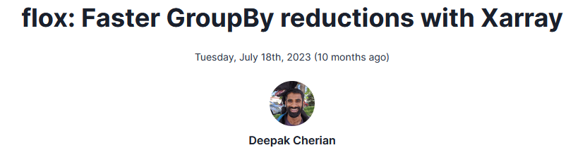
Bonus: faster groupby with flox
Better and faster algorithms
Optimized for parallel computing
Works with dask (see end of the day…)

Slide 51
Summary: first analyses
Select data with coordinates
Mask data with conditions
ds.sel(longitude=12, latitude=slice(0,40), time="2012")
ds.where(ds.temperature > 18)
Operation along dimension
Weighted operations
ds.max("depth")
ds.weighted(cell_size).mean(["longitude", "latitude"])
Resampling in time
Other resampling
Rolling windows
Interpolating on new coordinates
ds.resample(time="2H").min()
ds.coarsen(longitude=10, latitude=5, boundary="trim").max()
ds.rolling(depth=5, center=True)
ds.interp(longitude = [10, 20, 30], latitude=18)

Slide 52
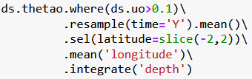
One-liners
As in pandas, methods return an xarray object (Dataset, DataArray)
Methods can be chained into one line:
ATTENTION: it can be better to split for development…

Slide 53
Easy conversion to pandas objects
xarray objects can be directly converted to pandas object

Slide 54
Part III: Practicals
Go to the jupyter notebook

Slide 55
Part IV: Scaling with dask
Handling out of memory datasets & parallel computing

Slide 56
Scaling issues
How to handle large amount of data (Here 63 GB)?
  Need large computers ?
Limited by memory size : can’t load more than memory size

Slide 57
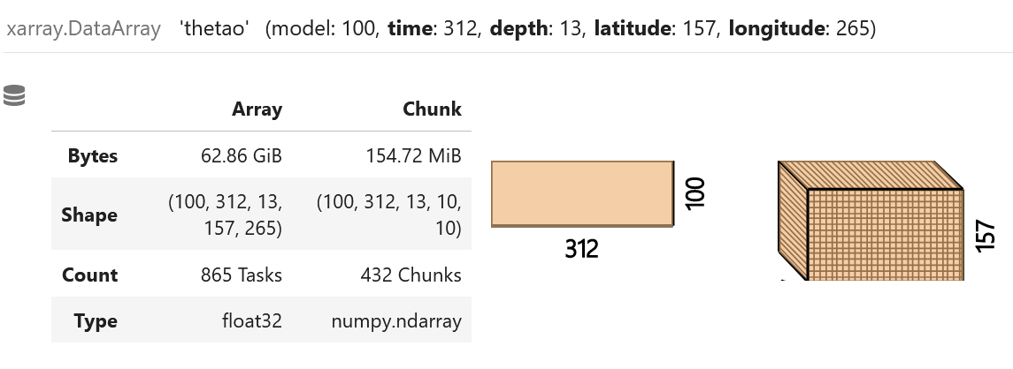
Introducing chunks
Split data into unit boxes

Slide 58
Lazy computing
When opening a file, only metadata, coordinates and dimensions are loaded
Compute stuff ...
The data are loaded into memory only when they are really needed (plotting, saving results, printing values)

Slide 59
Parallel computing
Operations on individual chunks
Sort operations
Computing them individually
DASK

Slide 60
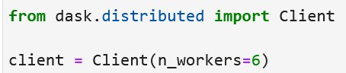
Quick setup
Providing resource information:
Specify explicit chunks:
Open multiple files: one chunk per file

Slide 61
Summary: why use dask?
Transparently integrated with xarray
Prevents memory issues
Speeds up operations with parallel computing
Optimized for HPC and cloud

Slide 62
Live example …

